Slide 1
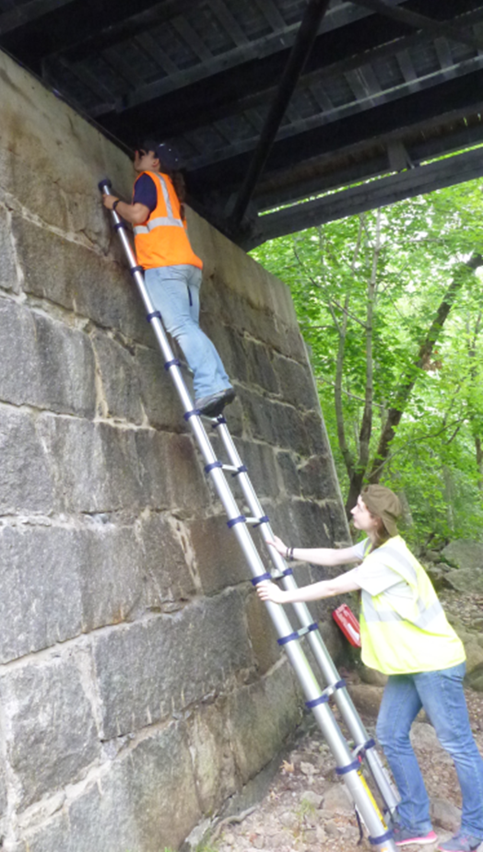
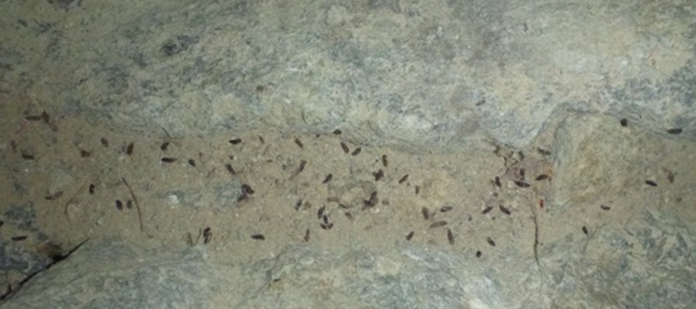
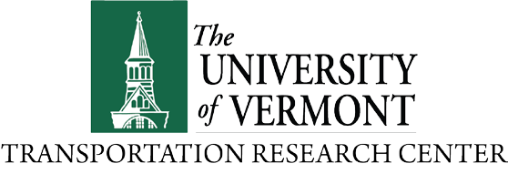
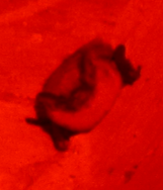
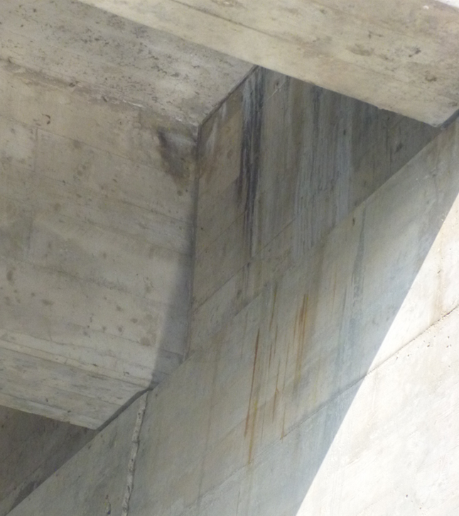
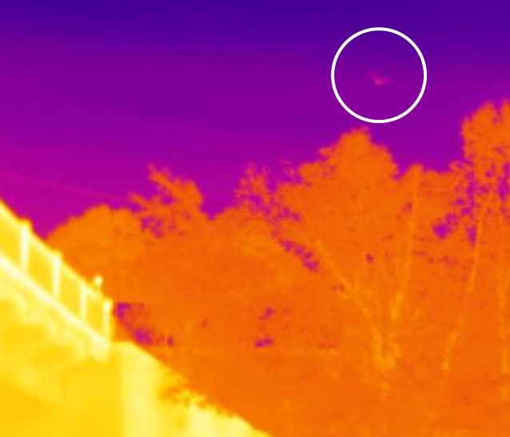
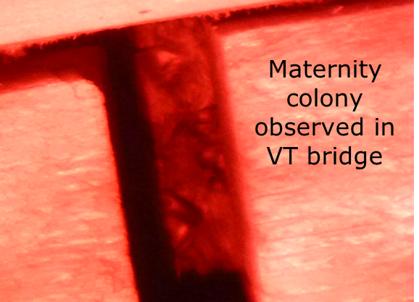
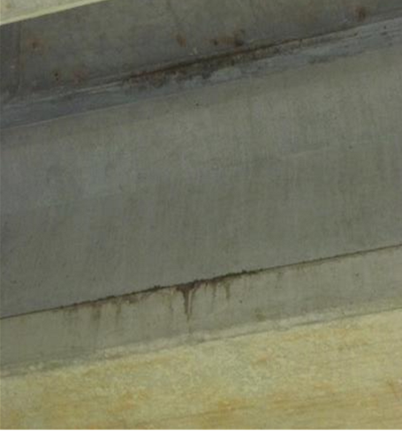
 | FACT SHEET
 | Investigation of Northern Long-Eared Bat Roosting Sites on Bridges
RESEARCH PROJECT TITLE Investigation of Northern Long-Eared Bat Roosting Sites on Bridges STUDY TIMELINE February 2015 – May 2017 PRINCIPAL INVESTIGATOR Scott Civjan, PI Betsy Dumont, Co-PI Alyssa Bennett, External Research Associate Angela Berthaume, Graduate Research Assistant NETC CONTACT Julie Dowds, MPA NETC Coordinator University of Vermont Transportation Research Center 210 Colchester Avenue Burlington, VT 05405 802-656-7722 netc@uvm.edu MORE INFORMATION NETC Coordinator will add link to the final report on NETC website The New England Transportation Consortium, a cooperative effort of the transportation agencies of the six New England States, funded this research. Through the Consor- tium, the states pool professional, academic and financial resources for transportation research leading to the development of improved methods for dealing with com- mon problems associated with the administration, planning, design, construction, rehabilitation, recon- struction, operation and mainte- nance of the region’s transporta- tion system. The NETC is hosted by the Univer- sity of Vermont Transportation Re- search Center | Introduction Populations of several non-migratory bat species have declined significantly in New England due to White-nose Syndrome, resulting in several species, including the Northern Long-Eared Bat (Myotis septentrionalis), being listed as threatened or endangered at the federal or state level. Bats are known to roost in bridges in other regions, but it was not known whether bridge roosting was utilized in New England, with only one known roost at the start of the project. Understanding the use of bridges by bat species will allow for proactive planning and mitigation to avoid harm to these species during repair and replacement projects. Methodology The project initiated with a literature review and interviews with personnel involved in tracking bat populations, inspecting bridges and researching bridge roosting. The project team selected eighteen bridges for in-depth study. Each of these bridges was evaluated through visual inspection, acoustic monitoring, thermal imaging, guano testing and evening monitoring of structures for emergence. Through the field work and data analysis the research team compared evaluation methods, developed a survey form for visual inspections and provided recommendations for best practices. Conclusion Through the project and/or reporting by state DOTs, bat roosting has been confirmed at thirteen New England bridges and highly suspected at another two. Comparisons and recommendations on evaluation methods (visual inspections, staining characteristics, acoustic monitoring and guano identification) were presented, with examples provided for each of the eighteen bridges. Non-agreement between automated acoustic bat identification software programs was noted along with the need for expertise in manual vetting. Recommendations for changes to the ‘Bridge/Structure Assessment Form’ from the U.S. DOT “Programmatic Biological Assessment for Transportation Projects in the Range of the Indiana Bat and Northern Long-Eared Bat” have been made, specifically recommending changes to non-representative photo examples, timing of inspections, and problems with defining “staining.” A survey form was developed to supplement the ‘Bridge/Structure Assessment Form.’ Federal regulations enacted during the course of the project preclude specific restrictions on bridge work due to the threatened Northern Long-Eared Bat (Myotis septentrionalis), however, requirements exist for the endangered Indiana bat (Myotis sodalis),. Additional state listings, the possibility of upgrading the federal listing due to declining populations and general best practices to avoid harming bat species add further relevance to the project. What are potential impacts? The results from this study provide guidance to DOT personnel to determine best practices for evaluating their bridge inventory, to understand data and techniques used by consultants, and to prepare strategies for the possibility of further listing or upgrading of bat species by USFWS.
p
s
o
n
r
a
t
r
a
t
T
i
o
d
n
n
C
a
o
l
g
n
n
E
w
e
N

